Slide 1
Notes:
Preparation: 1) make assistant a co-host with ability to share. 2) The assistant monitors “chat” and raises questions/comments as appropriate/needed. 3) Use “presenter View” and press Alt+F5 Slide #1 - #3: Show these three slides alternately while people are gathering on Zoom.

Slide 4
Notes:
Let us each take a moment to share our name and place of worship. I am Dick Hamm from Central Christian Church (Disciples of Christ) in Indianapolis. Susan, will you go next?
[SHE WILL CALL ON INDIVIDUALS ONE BY ONE.]

Slide 5
Notes:
O God, you love the whole world and each of us in it. Help us to love the world as you love it….loving each person in it, working for all to have the necessities of life. Open our hearts and minds to learn new perspectives as well as new facts about why there is hunger, why you want it eliminated from your Earth, and how we might participate in this holy work. In Jesus name. Amen.

Slide 6
Notes:
This “Word Cloud” contains some of the words I often hear when people explain why they attend this class. I wonder what one or two words you would use to express why you are here. Please share one or two such words with us now either verbally or via chat.

Slide 7
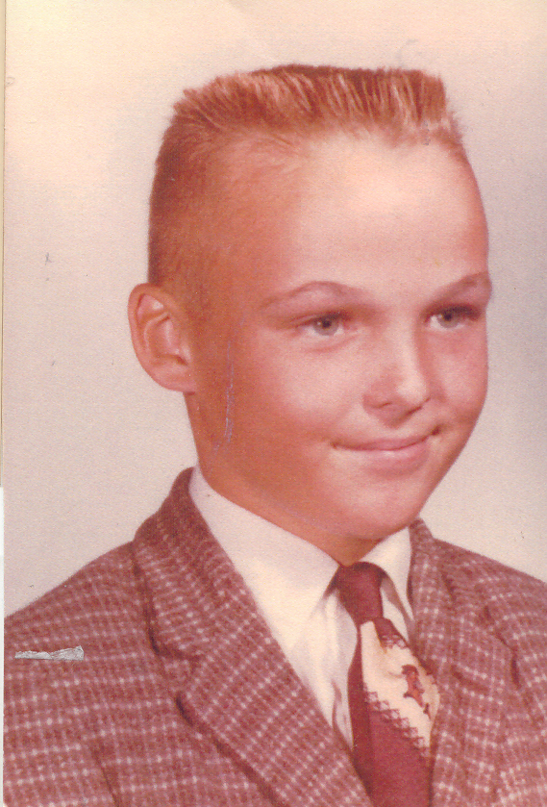
Notes:
I grew up in the Jim Crow South. I went to a white school and seldom encountered African Americans in my little white world. I saw them on the city buses, but they were in the back and I was in the front. They lived in a separate part of town where I never went.
But one year during Vacation Bible School, my class of 7th graders visited an African American Disciples church in that forbidden part of town. For nearly the first time in my life, I actually talked with Black people, though it was hard to know what to say after “Hello”. They seemed VERY different from me, yet very much the same. Why had I never spoken with these people before, and why did their church need to have a food bank for their members and their neighborhood? That was the beginning of my learning about segregation and poverty and how some people had way more than they needed and others had way less than they needed.

Slide 8
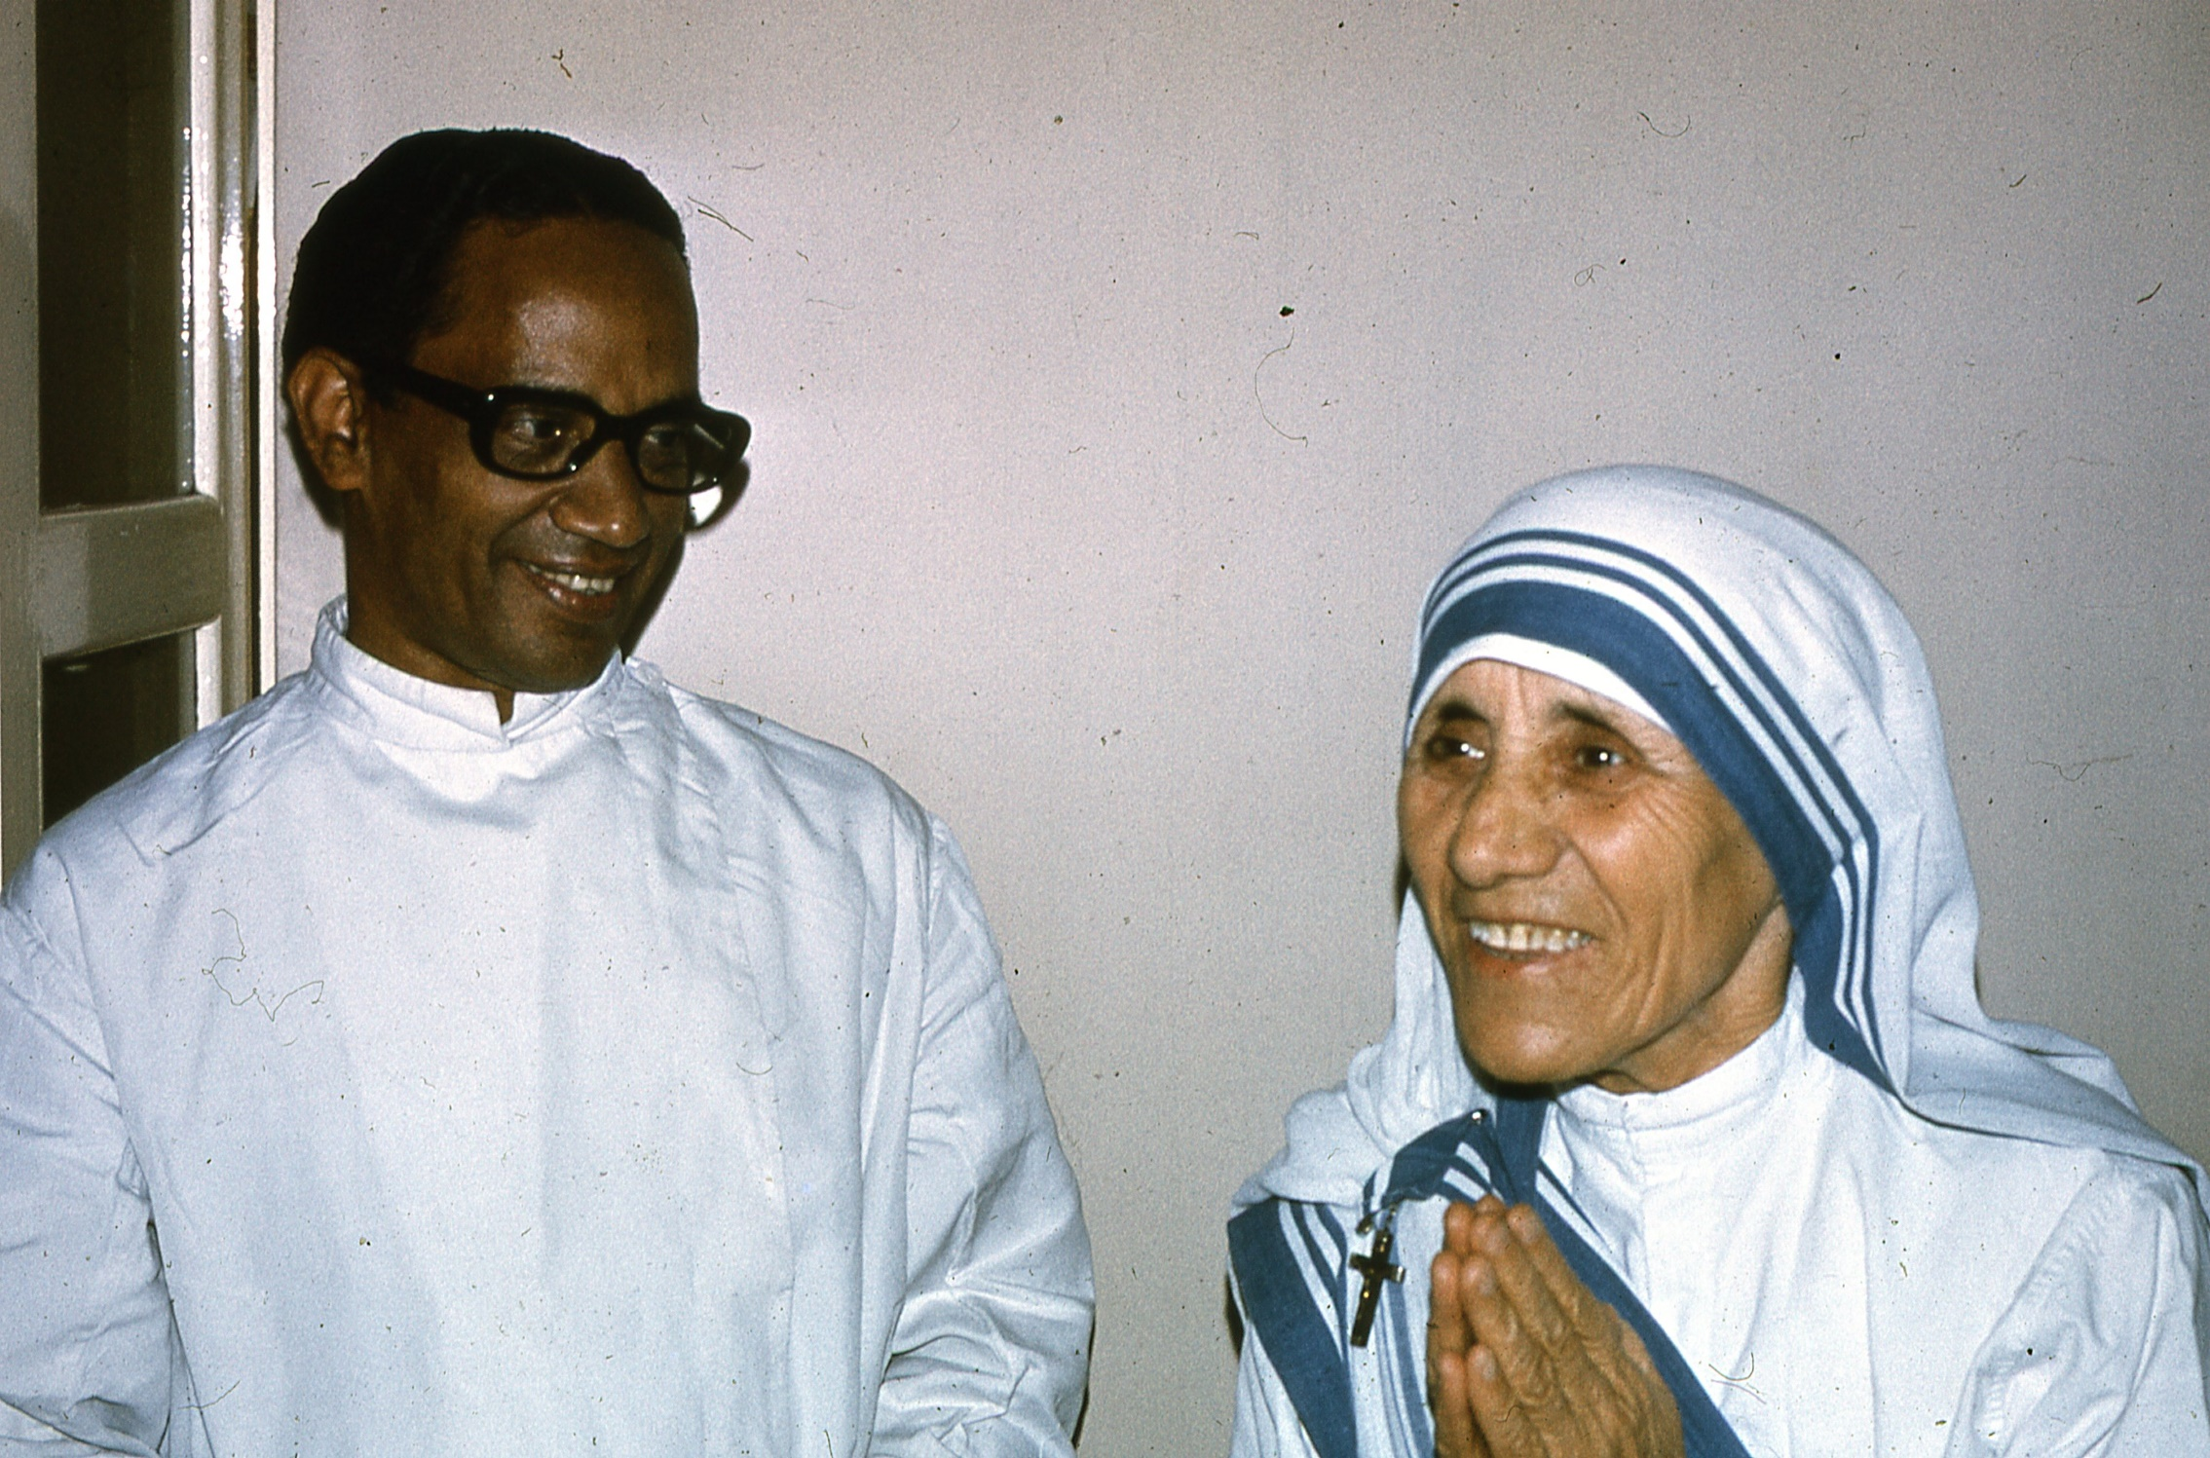
Notes:
Fast forward to Seminary when my wife and I spent several weeks traveling and studying in India. We met Mother Theresa (when she was still Sister Theresa) and encountered poverty that we had seen only in the pages of National Geographic.

Slide 9
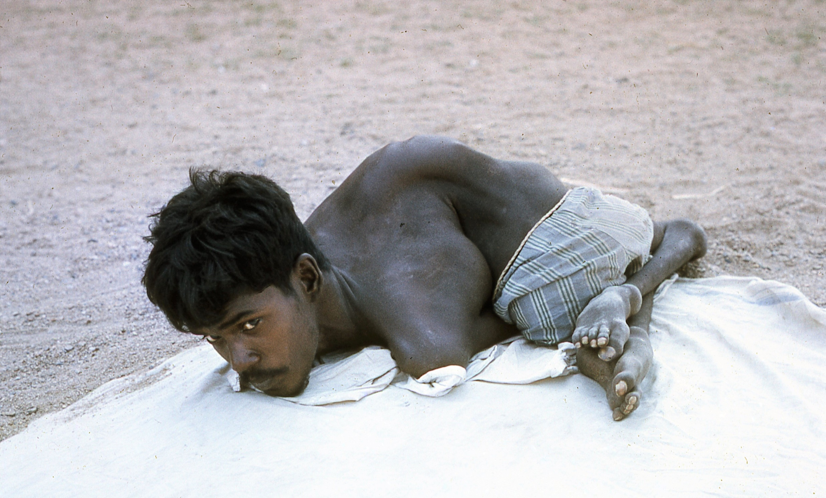
Notes:
Seeing the suffering, the question filled my brain: why do so many in the United States have so much and so many in India have so little? It is a question I have spent many years exploring, seeking to understand it and what can be done about it.

Slide 10
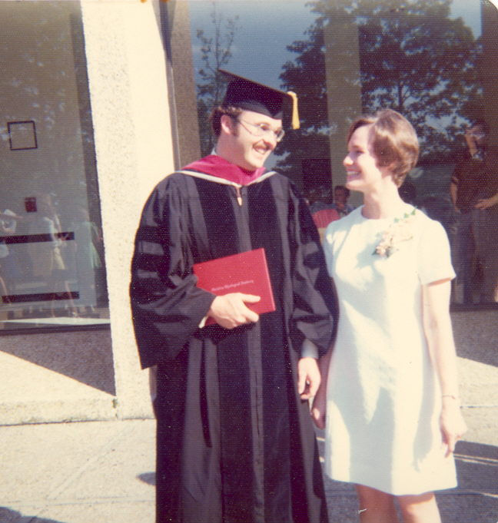
Notes:
Graduating in 1974 with a Doctor of Ministry degree that was focused on Christian ethics and economic development, I accepted my first full-time call as pastor of a church and joined a brand new organization that addressed these kinds of Christian concerns. It was called…..Bread For The World.
Throughout my ministry, in addition to being a pastor, preacher and teacher of the Gospel, I have looked for ways to help bring justice to our world: in fact, I have seen all these roles as part of the same call to ministry.

Slide 11
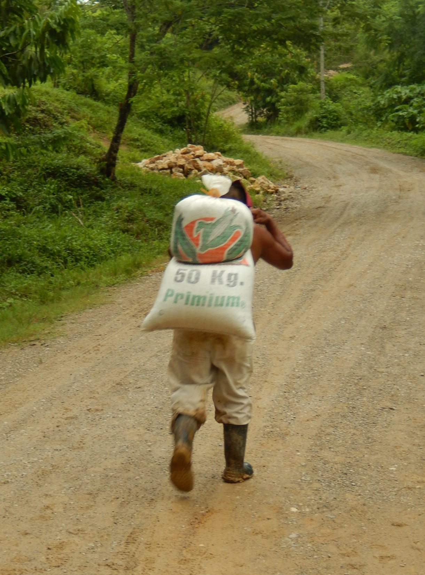
Notes:
Today, though retired, in the face of the death of George Floyd, poverty, climate change and environmental degradation, and hunger that falls disproportionately on people of color around the world, I am still trying to understand, still seeking ways to address the world’s inequalities, and still actively engaged as a member of Bread For The World. I have lived to see a reduction in poverty and hunger in the world, thanks be to God! But there is yet so much to do, so many children in our country and around the world who go to bed hungry every night. How can I as a Christian ignore this? I cannot. I can’t do everything, but I can do something! Bread For The World provides a way for me to make a difference.

Slide 12
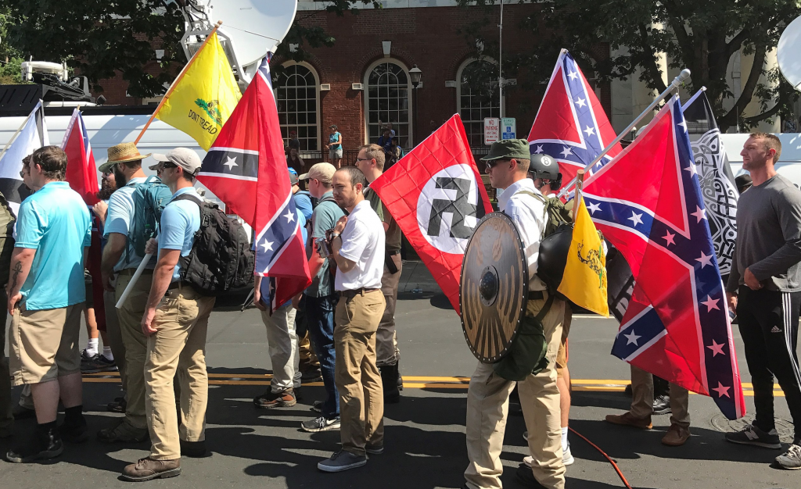
Notes:
So, you are not alone, if you admit to asking why there are inequalities in the world, and what is an appropriate Christian response. It still raises deep questions for me as well, questions like, “What changes would God desire? And, “What is all the resistance to change about?” And, “Why would some in the church continue to promote practices that defend unfair systems?” I have come to understand that we all need to test our attitudes and actions in comparison to the Gospel message of Jesus.

Slide 13
Class Overview
-Language and concepts
-The Biblical Witness
-Economic Systems
-What we can do
Notes:
As we think together about these things, I want to begin with some language and concepts we can use to talk about these things, then move to what the Bible says. Then, we’ll unpack a bit of how economic systems operate and our part in them and finish up by talking about what we can actually do about all this.

Slide 14
Notes:
Let’s begin by establishing some language and concepts we can use together in our conversation. When we think of “people”, most of us think in terms of individuals or a group of individuals. But we also need to think in terms of “systems”, which are individuals and groups that relate to each other in some larger social structure.
For example, individuals relate to each other in a larger social structure called “family”. Individual employees and their employers relate to each other in a larger social structure called a “company” or “corporation”, and workers may relate to each other and their companies through a larger social structure called a “union”.
We are all a part of many different systems. The more people involved, the more complex the system. Individuals can impact systems, but systems always impact the individuals that are part of them.
Let’s see if, either verbally or by chat, we can each name some systems of which most or all of us are a part. [Popcorn answers – typical responses would be a congregation, a denomination, the United States, a State, a club, a school, Bread, etc.]

Slide 15
Notes:
Human Systems are complicated and effect different people positively and/or negatively. For example, an economic system helps most people make a living, but an inequitable system can hurt some people and make it hard for them to make a living. ​
Human Systems can become very complicated and they all resist change, even if they claim to be all about change. In fact, amazingly, systems will often resist change even if it means their own death!
Can you, either verbally or via chat, identify some human systems that are difficult to change?
[If no one can name any and the group seems not to be “getting this”, I can name the following example: “For example, families are hard to change. Corporations are hard to change: the Kodak company resisted the advent of digital photography and so insisted on continuing to make and process film, which was eventually replaced by digital technology. Kodak employed 145,000 people worldwide at its height – that’s a BIG system! But it employed only 8800 people worldwide when it went bankrupt in 2013. Systems resist change!” “Churches are a kind of human system and can be very frustrating because they are difficult to change. But this shouldn’t surprise us, because they are created to conserve things: important ideas, resources, points-of-view, ways of being, and so forth. Churches are hard to change because they are created to conserve things that seem to be important at the time.]

Slide 16
Notes:
Two more important terms are “charity” and “justice”. Charity, as we usually use the word, means providing help in the form of money, clothing, food or other necessities to individuals in need. This is good work to which Christians are, of course, called. Examples of charity include direct giving to persons in need, giving through a food bank, a clothing bank, Goodwill, a benevolence fund that helps individuals with utility bills, and such.

Slide 17
Notes:
While “charity” involves helping individuals, “justice” refers to people being in right relationship to each other and to the larger systems of our society. In this culture, when we think “justice”, we may think of “criminal justice”: “If you do the crime, you do the time!”
But the Bible more often thinks of justice as people being in right relationship to each other and to the systems of their society. The Bible is interested in people being in right relationship with each other so that a society is fair to all, so that there is a reasonable distribution of wealth among the populace so you don’t have one class of people living in mansions while another class of people lives in the streets; people being in right relationship means everyone has equality of opportunity for personal development and advancement; it means the human rights of everyone in the system are protected.

Slide 18
Notes:
A prophet, in the Biblical sense, is not a seer or a fortune teller. Rather, a prophet is​ one who sees how things are; shows how they would be if there were justice; and tells how things will likely turn out if nothing changes, if injustices are not corrected.

Slide 19
Notes:
Let’s take a moment to discuss these terms and concepts. We’re going to put you in break-outs of three, randomly chosen, and ask you to discuss two questions (two minutes for each question): 1) ​Do you agree with the definitions presented?​ 2) What new ideas have you heard so far?
OK? Here we go into groups of three. [Dick puts in groups of three (move cursor to “share screen” to reveal three dots and the button for breakouts), Susan types questions into chat. When we come back from chat:] In your group, was there general agreement with these definitions? In your group, which of these terms or ideas were new to you?

Slide 21
Notes:
The fact is, every major religion in the world has an ethic that requires its adherents to take care of those who are in need!

Slide 22
Notes:
In Judaism, justice was first understood by the Hebrews in individual terms:​ the individual receiving fair judgments in trials and true value for labor and for money in purchases, and so forth. Moses taught this kind of individual justice.
But by the 8th century B.C., social justice (or systemic justice) became a major concern expressed through the prophets of that day.

Slide 23
Notes:
Those who are fond of predicting the end of the world often use selected quotes from the Old Testament prophets to make their case even though, as we said, Biblical prophets don’t predict the future but instead tell what will likely happen if there is no change.
All the apocalyptic (end time) talk these days raises the question: “Is God a Destroyer or a Transformer”. Is God planning to destroy the world ultimately or is God working to transform it? To ask it another way, is God apocalyptic or gracious? ​Both views of God are present in the Bible, but the great majority of the Hebrew prophets, and Jesus, lean toward God as transformer.
This is why Dr. King could say, “The long arc of history bends toward justice.” The transformation often seems slow in coming, but it is unfolding over time.

Slide 24
Notes:
So Amos says, “Even though you offer me your burnt offerings and grain offerings, I will not accept them. Take away from me the noise of your songs;​ I will not listen to the melody of your harps.​ But let justice roll down like waters,​ and righteousness like an ever-flowing stream.​”

Slide 25
Notes:
Likewise, the Prophet Micah – will someone please read these words from Micah?
“With what shall I come before the Lord, and bow myself before God on high? Shall I come before him with burnt offerings, with calves a year old? He has told you, O mortal, what is good; and what does the Lord require of you, but to do justice, love kindness, walk humbly with your God.” Powerful words! A powerful calling!

Slide 26
Notes:
Likewise, Jesus comes out of this same tradition. As he began his ministry in Nazareth, he read these words from Isaiah: “The Spirit of the Lord is upon me, because he has anointed me to bring good news to the poor. He has sent me to proclaim release to the captives and recovery of sight to the blind, to let the oppressed go free....”

Slide 27
Notes:
And we remember Jesus’s “Parable of the Last Judgement” in which the sheep are separated from the goats: will someone please read this? “The king will say to those at his right hand, “I was hungry, and you gave me food.”​
The righteous will answer him, “Lord, when was it we saw you hungry and gave you food?”​
And the king will answer them, “Truly I tell you, just as you did it to one of these, you did it to me.”

Slide 28
Notes:
And in the New Testament, James notes the fact that right belief is only part of Christianity. As important as faith is works. He says, “Faith without works is dead!”

Slide 29
Notes:
Catholic Social Teaching is deeply rooted in scripture and in church history. It includes these three criteria:
--A basic moral test is how our most vulnerable members are faring. ​
--We are one human family whatever our national, racial, ethnic, economic, and ideological differences. We are our brothers’ and sisters’ keepers, wherever they may be. ​
--We show our respect for the Creator by our stewardship of creation. We are called to protect people and the planet, living our faith in right relationship with all of God’s creation.

Slide 30
Notes:
And Pope Francis says, “We have forgotten and are still forgetting that over and above business, logic, and the parameters of the market is the human being … All human activity, including economic activity, must be ethically structured and governed.​”

Slide 31
Notes:
John Calvin, a leader of the Reformation, taught us not to completely trust ourselves or our tools – including our systems! He taught that we need to be careful about splitting the spiritual and physical as though they have no relationship to each other, because doing so can lead us to interpret Jesus’ teachings as about some spiritual realm only that does not speak to the physical realm of this world. And he teaches us that no system is perfect or can eliminate human sinfulness.​ We do well to remember this when we think about the world’s different economic systems.

Slide 32
Notes:
Different economic systems address the question of wealth differently: but remember, as Calvin says, none of these systems is perfect!
There are centrally planned economies including communism (which history has shown quickly becomes corrupt), and socialism (which offers more security for the individual but somewhat less opportunity)​
And there are market driven economies​, including capitalism.
Well, two cheers for Capitalism!

Slide 33
Notes:
Why only two cheers? Because while capitalism does tend to create wealth for many, it is also plagued by such problems as monopolies, collusion, and exploitation and tends to create huge gaps in wealth. It is only as capitalism is monitored and regulated that it can support a just society. There really is no such thing as a truly “free” market that is also “just”.
Most modern economic systems are a blend of capitalism and various degrees of socialism. The Netherlands, for example, have struck a balance in which health care and higher education are provided to all, while capitalists are still able to make profits.
In the United States, we subsidize airports, railroads and highways, but health, higher education, and child-care are still mostly market driven. The gap between rich and poor has been growing steadily so that according to the Economic Policy Institute, in the top 350 U.S. corporations chief Executive Officers pay is on average 278 times that of their workers’ average pay. At some companies, like Walmart, the multiple is over 1000.

Slide 34
Notes:
The fact is that “trickle down” economics does not work….it does not create greater wealth at the bottom but exacerbates the gap between the wealthy and the poor. Yet, providing opportunity and meeting the needs of the poor create wealth for all. It is unjust social systems that sustain poverty, and yet those of us who are privileged are taught to believe that the poor are poor simply due to their own faults….. I prefer “trickle up” economics!

Slide 35
Notes:
We have rationalized the gap between wealthy and poor as shown in this slide and the next. I think all of us have heard most of these and probably have thought them. [talk about each of these briefly]
{RE: “Separation of Church and State”}: Some people will say that we have to maintain the separation of Church and state” {change slide}

Slide 36
Notes:
But the church has always addressed systemic issues through laws and legislation, including abolition, public education, hospitals, civil rights, and prison reform.

Slide 37
Notes:
[talk about each of these briefly, then say….] No doubt there are cases where people have failed to help themselves when they could, but most people are doing the best they know how to provide for themselves and their families.

Slide 38
Notes:
The fact is that unless there are interventions for the sake of greater justice, poverty will continue unabated.
The critical question when seeking to understand the level of justice in a system is this: “Who benefits from the system as it is?” If only the rich benefit, something is wrong, something is not fair, not just. For example, in a system like ours in the United States, if the rich are not paying their fair share of taxes, something is wrong. If only landlords have rights and tenants have none, something is wrong. If people who work full-time still can’t put food on the table, something is wrong.

Slide 39
Notes:
Understandably, those of us who have means (which is all of us) prefer not to admit that hunger is caused by systemic societal forces, since we benefit from many of those same forces, and so we prefer not to admit that change is possible. Life is moving at such a pace these days that we just don’t feel like we have the bandwidth to address these systemic issues. To do so calls for a reordering of our priorities, which is difficult - but necessary if we are to respond to Jesus’s call for us to do justice.

Slide 40
Notes:
Yet, we know God is actively working to bring about a humane world, where every child, every person, has a chance at fulness of life. “Do justice, love kindness, walk humbly with your God!” “Do unto others as you would have them do unto you.” This is our calling as people of God, especially as people of God who have some measure of power and privilege.

Slide 41
Notes:
Though we sometimes suffer from compassion fatigue, we are sometimes overwhelmed by our own problems, and so forth….there is no denying it: doing justice, loving kindness, and walking humbly with our God” is our calling as people of God.
So, let’s talk about this issue of “taking responsibility” for a bit. Tell me, is the issue of taking responsibility for change an issue for you and how are you feeling right now? [Discussion]

Slide 42
Notes:
Lest we feel overwhelmed, here is my advice: We don’t individually have to solve every problem by ourselves. We just need to pick some things that we can do, do them, and feel good about doing them!
In the process, we have the great joy of working with others who are seeking to do the same!

Slide 43
Notes:
So, what can we do? 1) Give as we are able to charity and to organizations that are working for justice; and 2) work to change the systems!

Slide 44
Notes:
We have lots of places where we can make financial contributions. Here are some of them. For example, we can support relief and development programs. Some outstanding examples include Oxfam; World Vision; One Great Hour of Sharing, Week of Compassion, Heifer Project, Catholic Relief Services, Lutheran Social Services, Church World Service, and Habitat For Humanity.

Slide 45
Notes:
We can support local efforts through a food bank and feeding programs. You can support legislation such as that which provides for SNAP, good farm bills, foreign aid that focuses on food and economic development, and supports good public schools.

Slide 46
Notes:
We can educate ourselves, and communicate with legislators via letters, emails, and phone calls.
This could all be overwhelming if you tried to do it all by yourself. But if you participate in Bread for The World, you have clear, expert, help and steps to take!

Slide 47
Notes:
We have a few minutes so let’s go back into small groups and respond to these three questions: is your congregation responding to hunger issues? If yes, are they working through charity or changing systems, or both? Can you think of other ways in which your congregation might respond to these issues? Here we go! [start break outs, Susan puts questions in chat]

Slide 48
Notes:
Though we all have our own challenges in life, we can’t just walk on the other side of the road. There is no denying it: “doing justice, loving kindness, and walking humbly with our God” is our calling as people of God. This is what God has to do with it! Happily, thankfully, Bread for The World provides an important way for us to make a difference together!
Thank you for being a part of this seminar. Thank you for your concern for the well-being of all of God’s children, our brothers and sisters.

